Slide 1

Bored
CREATORS: AJITESH MUPPURU, SHERWIN NEWTON, JACOB OGOREK, ETHAN POTTS
MENTOR: QUINCY CAROLAN

Slide 2
Brainstorming
“Help Make Life Go Right”
What, as teenagers, is a problem in our own lives
Boredom
Laziness, overusing social media

Slide 3
Boredom:

Slide 4
Concept
Bored is a rejuvenated incarnation of local-search services like Yelp, TripAdvisor, etc. With curated streaming services becoming the forefront of entertainment, we at Bored believe that finding something fun to do needs to be easy, intuitive, and catered to you.

Slide 5
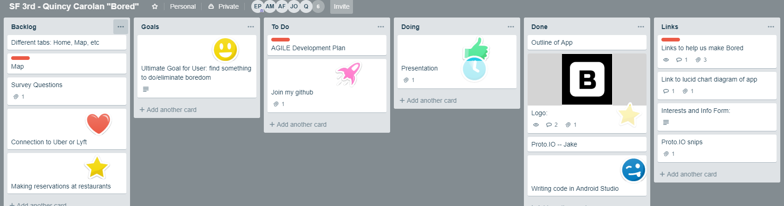
Collaborative Services
Trello, Github, Google Classroom

Slide 6

Prototype

Slide 7
UX

Slide 8
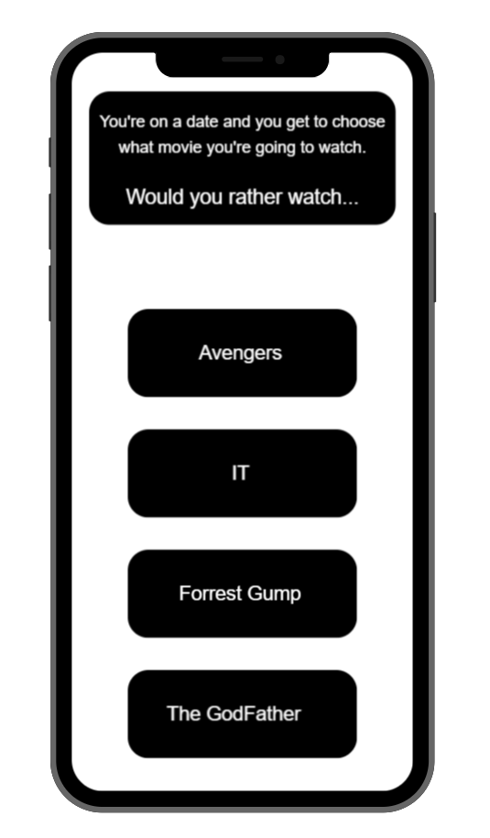
Intuitiveness
Our app learns who you are, the habits you have, and the hobbies that you’re interested in. Using this data, Bored generates local activities curated to your interests for you to do if you’re feeling lazy.

